Slide 1
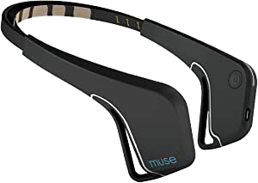



Maze game controlling from brain signals
Robot simulation ( Maze game)
S1
Python scripts
EEG
EEG
Results
MUSE
ROS
Acquire EEG data and Detect eye blink.
EEG
Results description
S2
True and True
Result : 3
EEG
S1 and S2 blink eye.
S1 blinks eye.
True and False
Result : 1
S2 blinks eye.
False and True
Result : 2
MUSE
S1 and S2 blink eye.
False and False
Result : 4

